Slide 1
Pillars Reconfiguration Example: 2 PEs

Slide 2
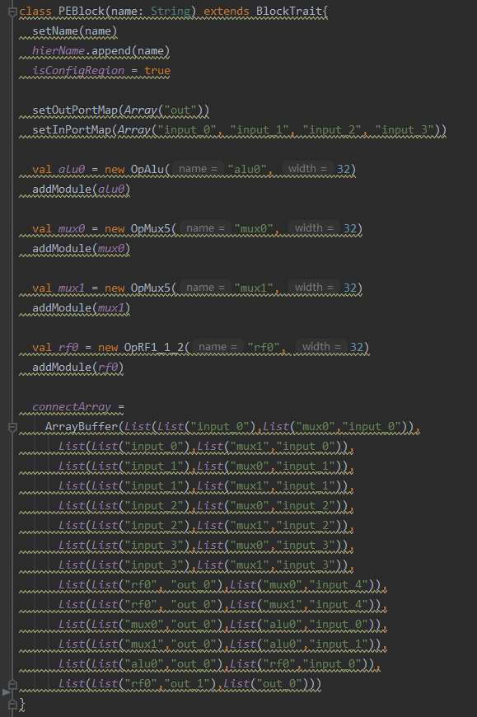
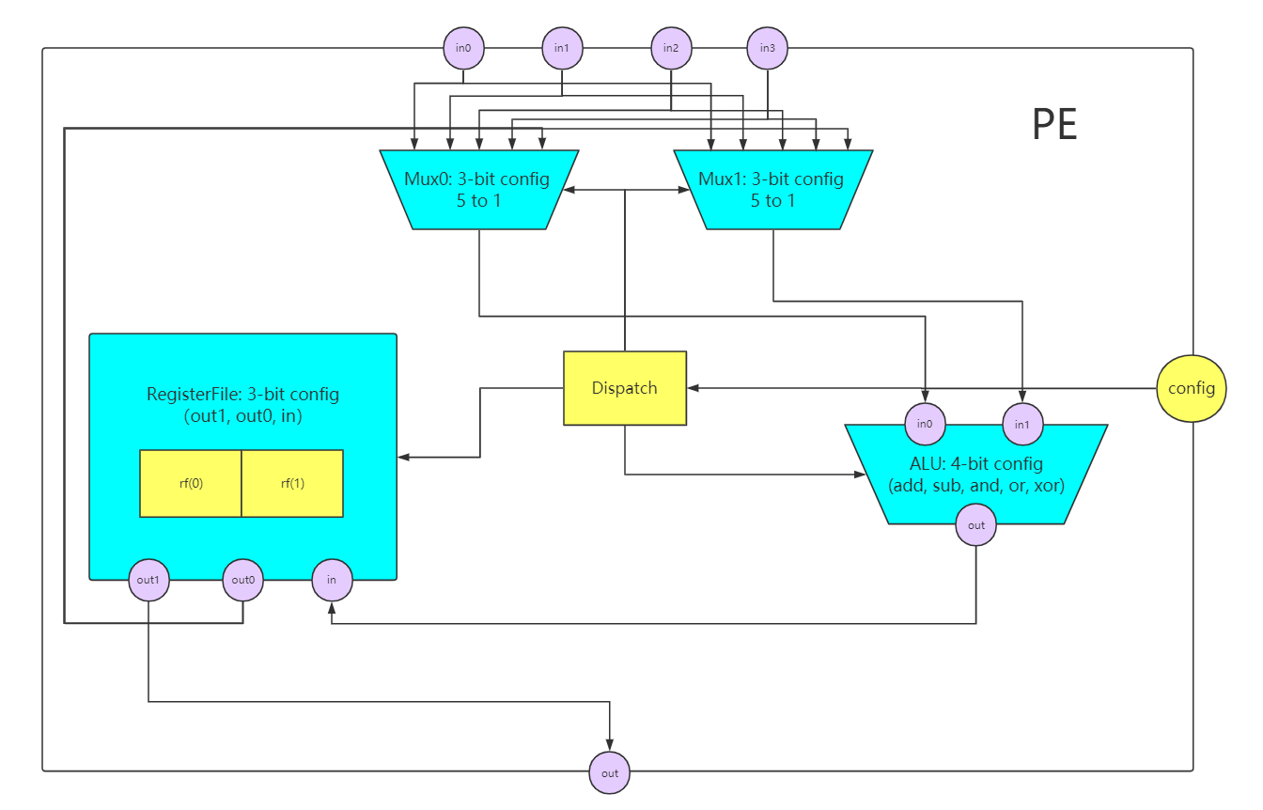
Single PE description

Slide 3
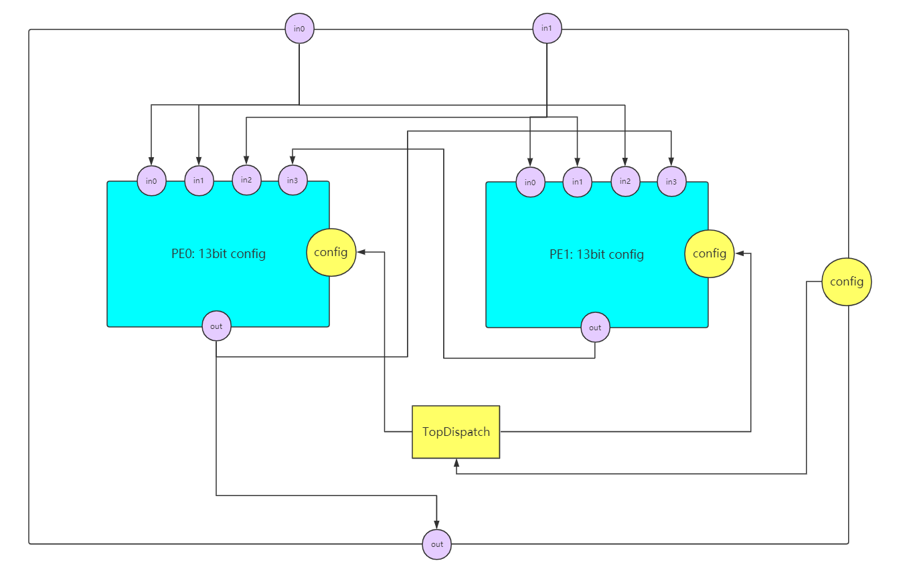
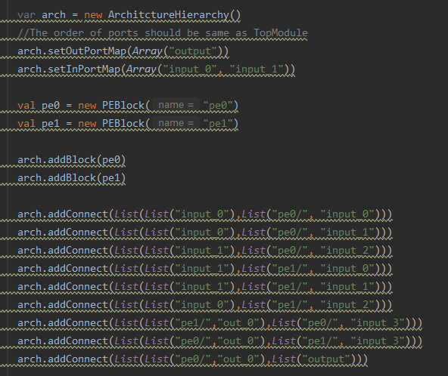
Top module description

Slide 4
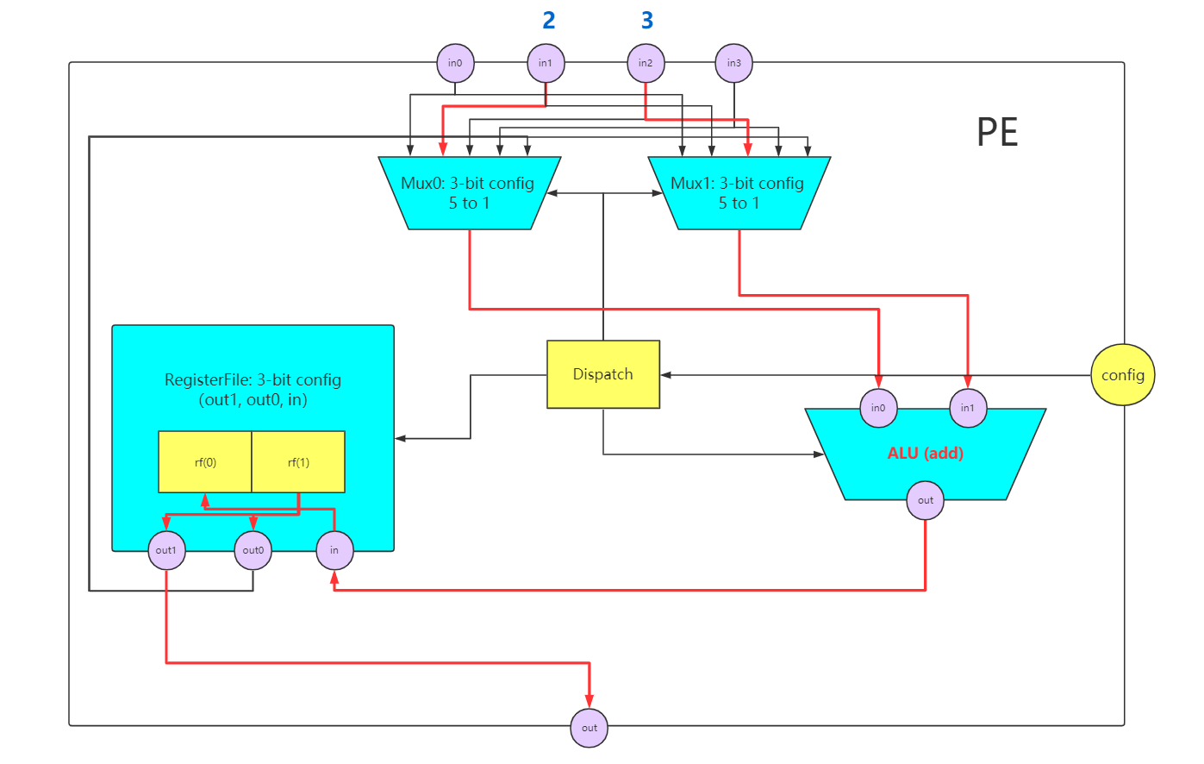
Reconfiguration test – cycle 0
Poke 2 into in0
Poke 3 into in1
Config:
010 001 001 0001 010 001 001 0000
PE0: 010 001 110 0000
mux1(3) pe0.in2(3)
mux0(3) pe0.in1(2)
register(3) (rf(1) -> out1(output), rf(1) -> out0(to self), input -> rf(0))
alu(4) add

Slide 5
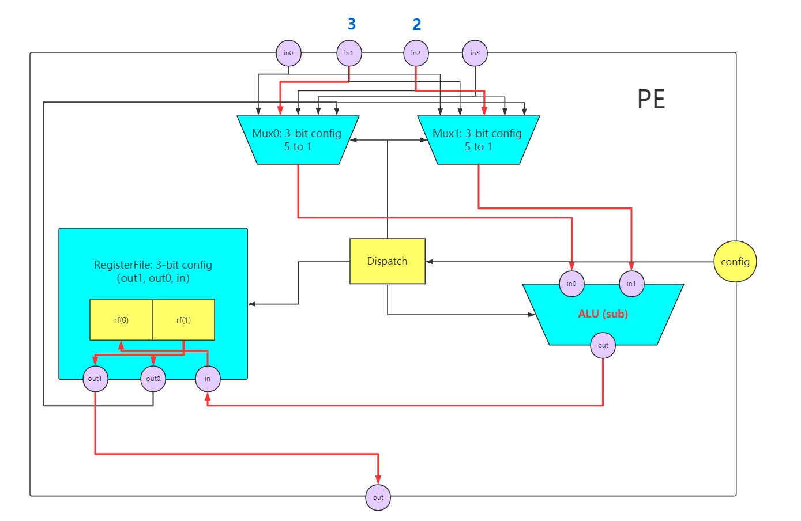
Reconfiguration test – cycle 0
PE1: 010 001 110 0001
mux1(3) pe0.in2(3)
mux0(3) pe0.in1(2)
register(3) (rf(1) -> out1(output), rf(1) -> out0(to self), input -> rf(0))
alu(4) sub

Slide 6
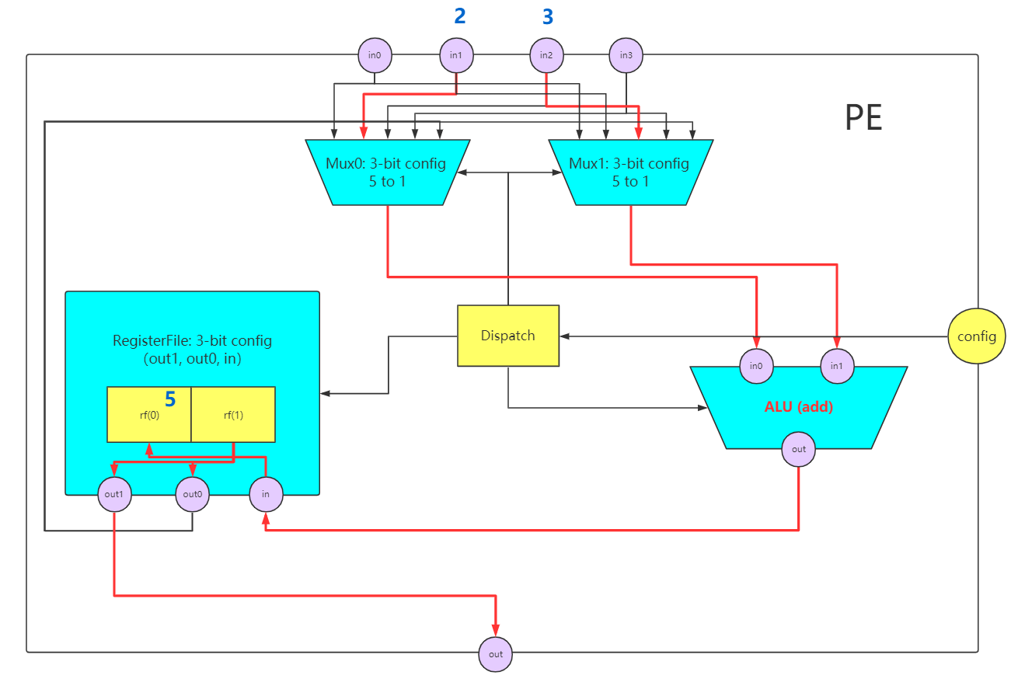
Reconfiguration test – cycle 1 （PE0）

Slide 7
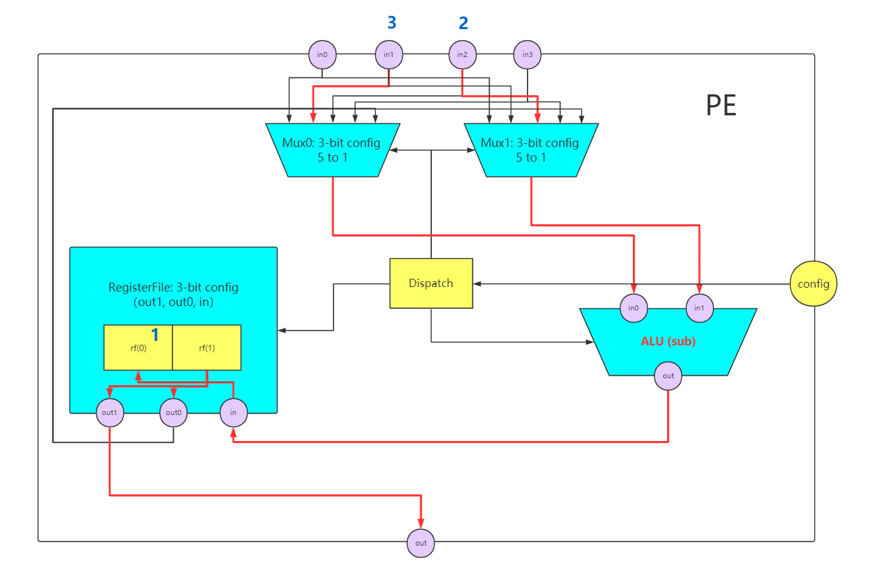
Reconfiguration test – cycle 1 （PE1）

Slide 8
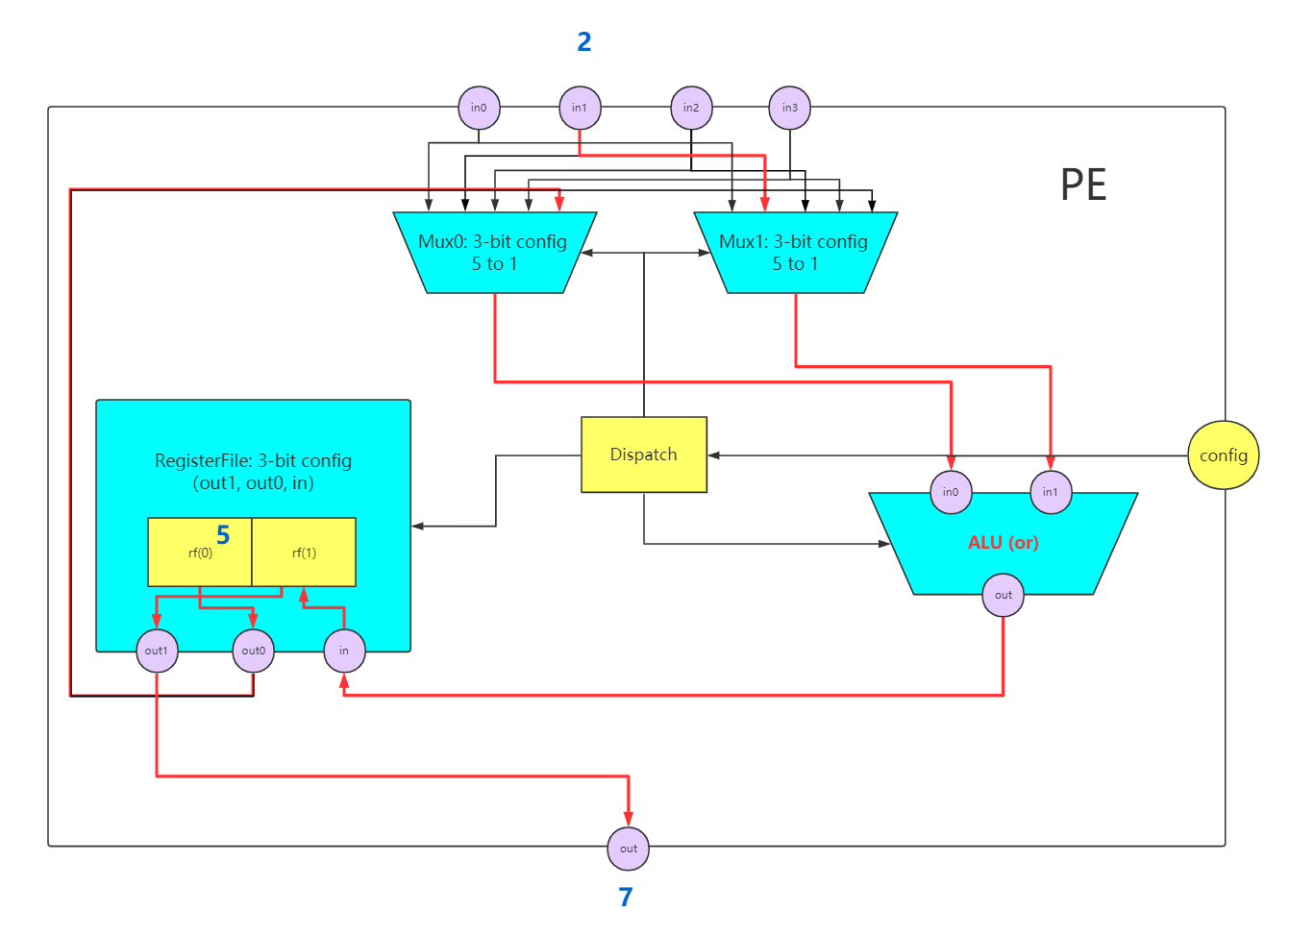
Reconfiguration test – cycle 3 (PE0)
New Config (cycle 2):
001 100 101 0011 001 100 101 0011
Output is 2 due to SyncReadMem in cycle 2
PE0: 001 100 101 0011
mux1(3) pe0.in1(2)
mux0(3) rf.out1
register(3) (rf(1) -> out1(output), rf(0) -> out0(to self), input -> rf(1))
alu(4) or

Slide 9
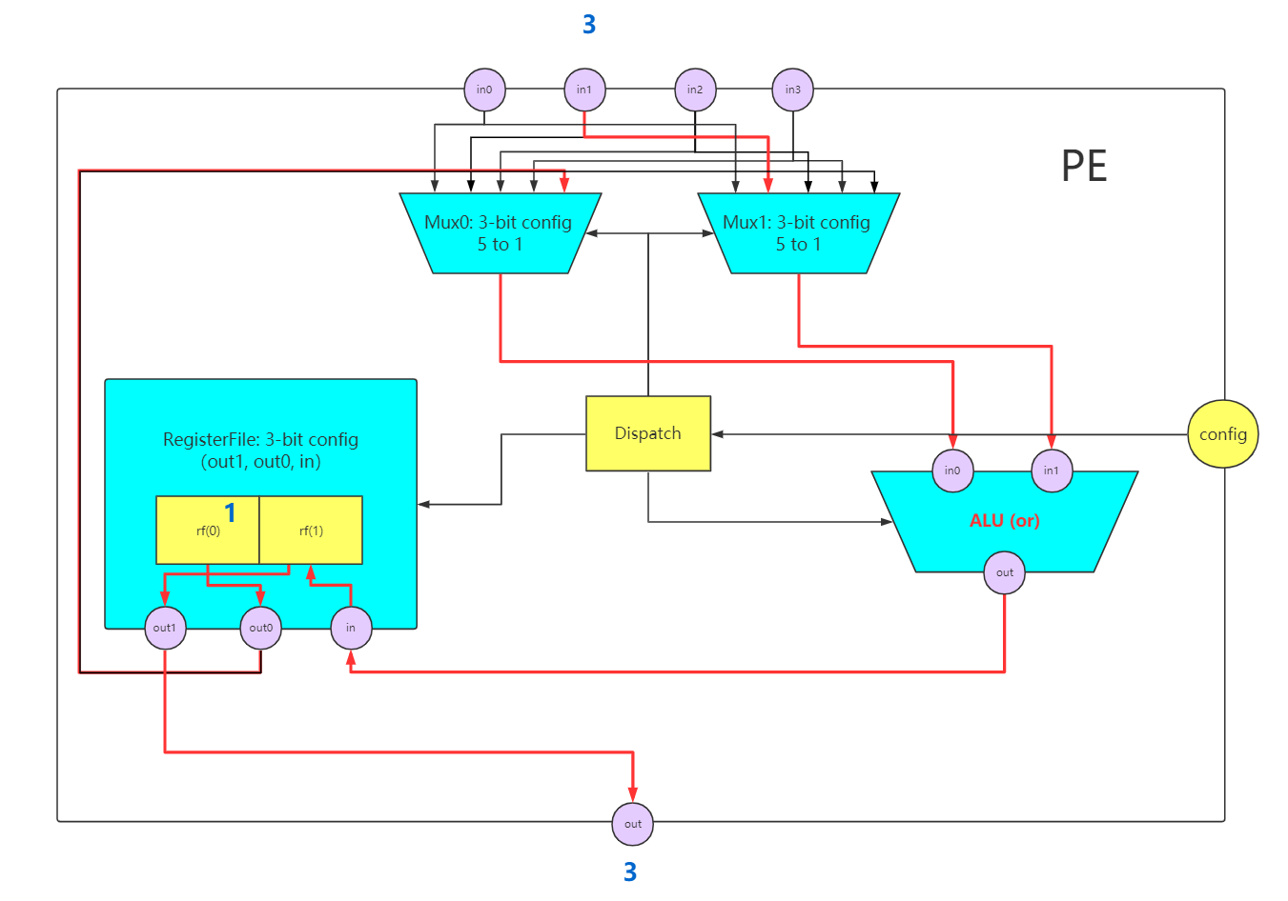
Reconfiguration test – cycle 3 (PE1)
PE1: 001 100 101 0011
mux1(3) pe0.in1(2)
mux0(3) rf.out1
register(3) (rf(1) -> out1(output), rf(0) -> out0(to self), input -> rf(1))
alu(4) or

Slide 10
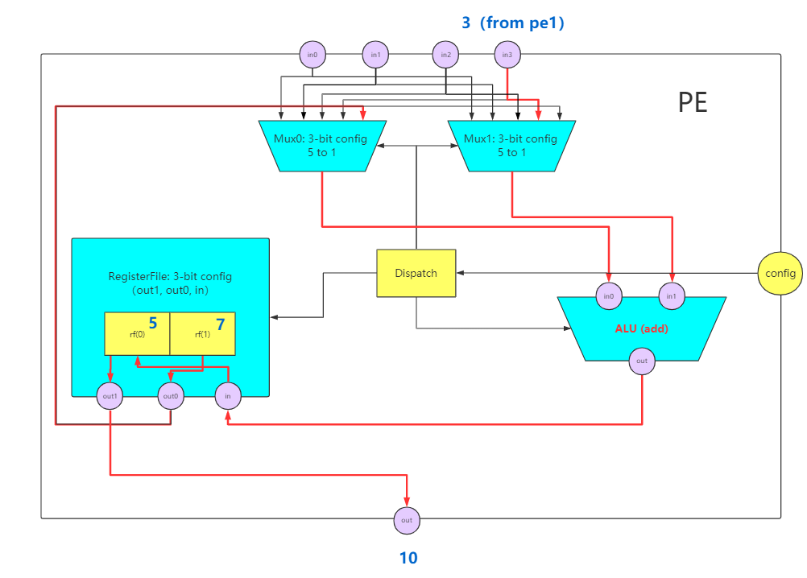
Reconfiguration test – cycle 5 (PE0)
New Config (cycle 4):
000 000 100 0000 011 100 010 0000
Output is 8 due to SyncReadMem in cycle 4
PE0: 011 100 010 0000
mux1(3) pe0.in3(from pe1)
mux0(3) rf.out1
register(3) (rf(0) -> out1(output), rf(1) -> out0(to self), input -> rf(0))
alu(4) add

Slide 11
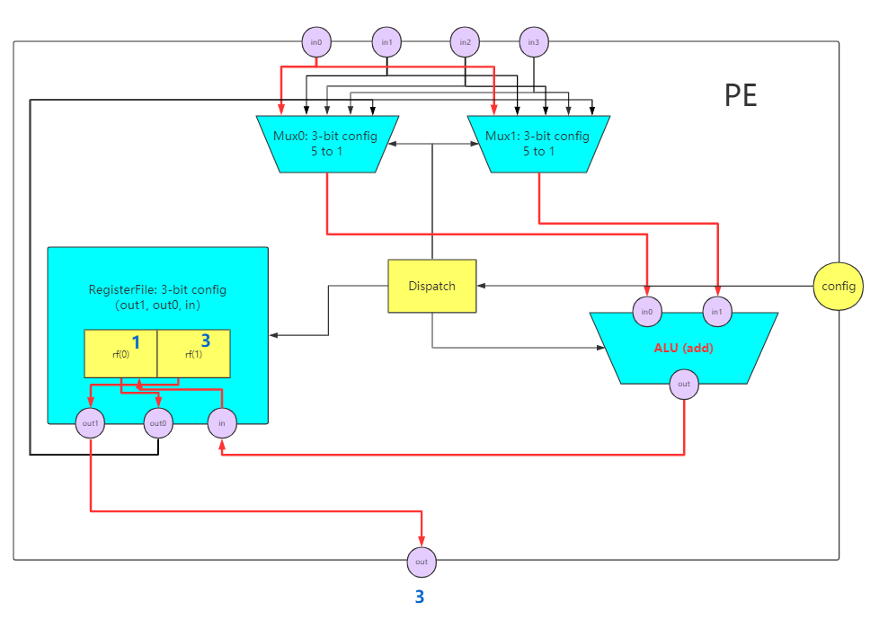
Reconfiguration test – cycle 5 (PE1)
PE1: 000 000 100 0000
mux1(3) in0
mux0(3) in0
register(3) (rf(1) -> out1(output), rf(0) -> out0(to self), input -> rf(0))
alu(4) add

Slide 12
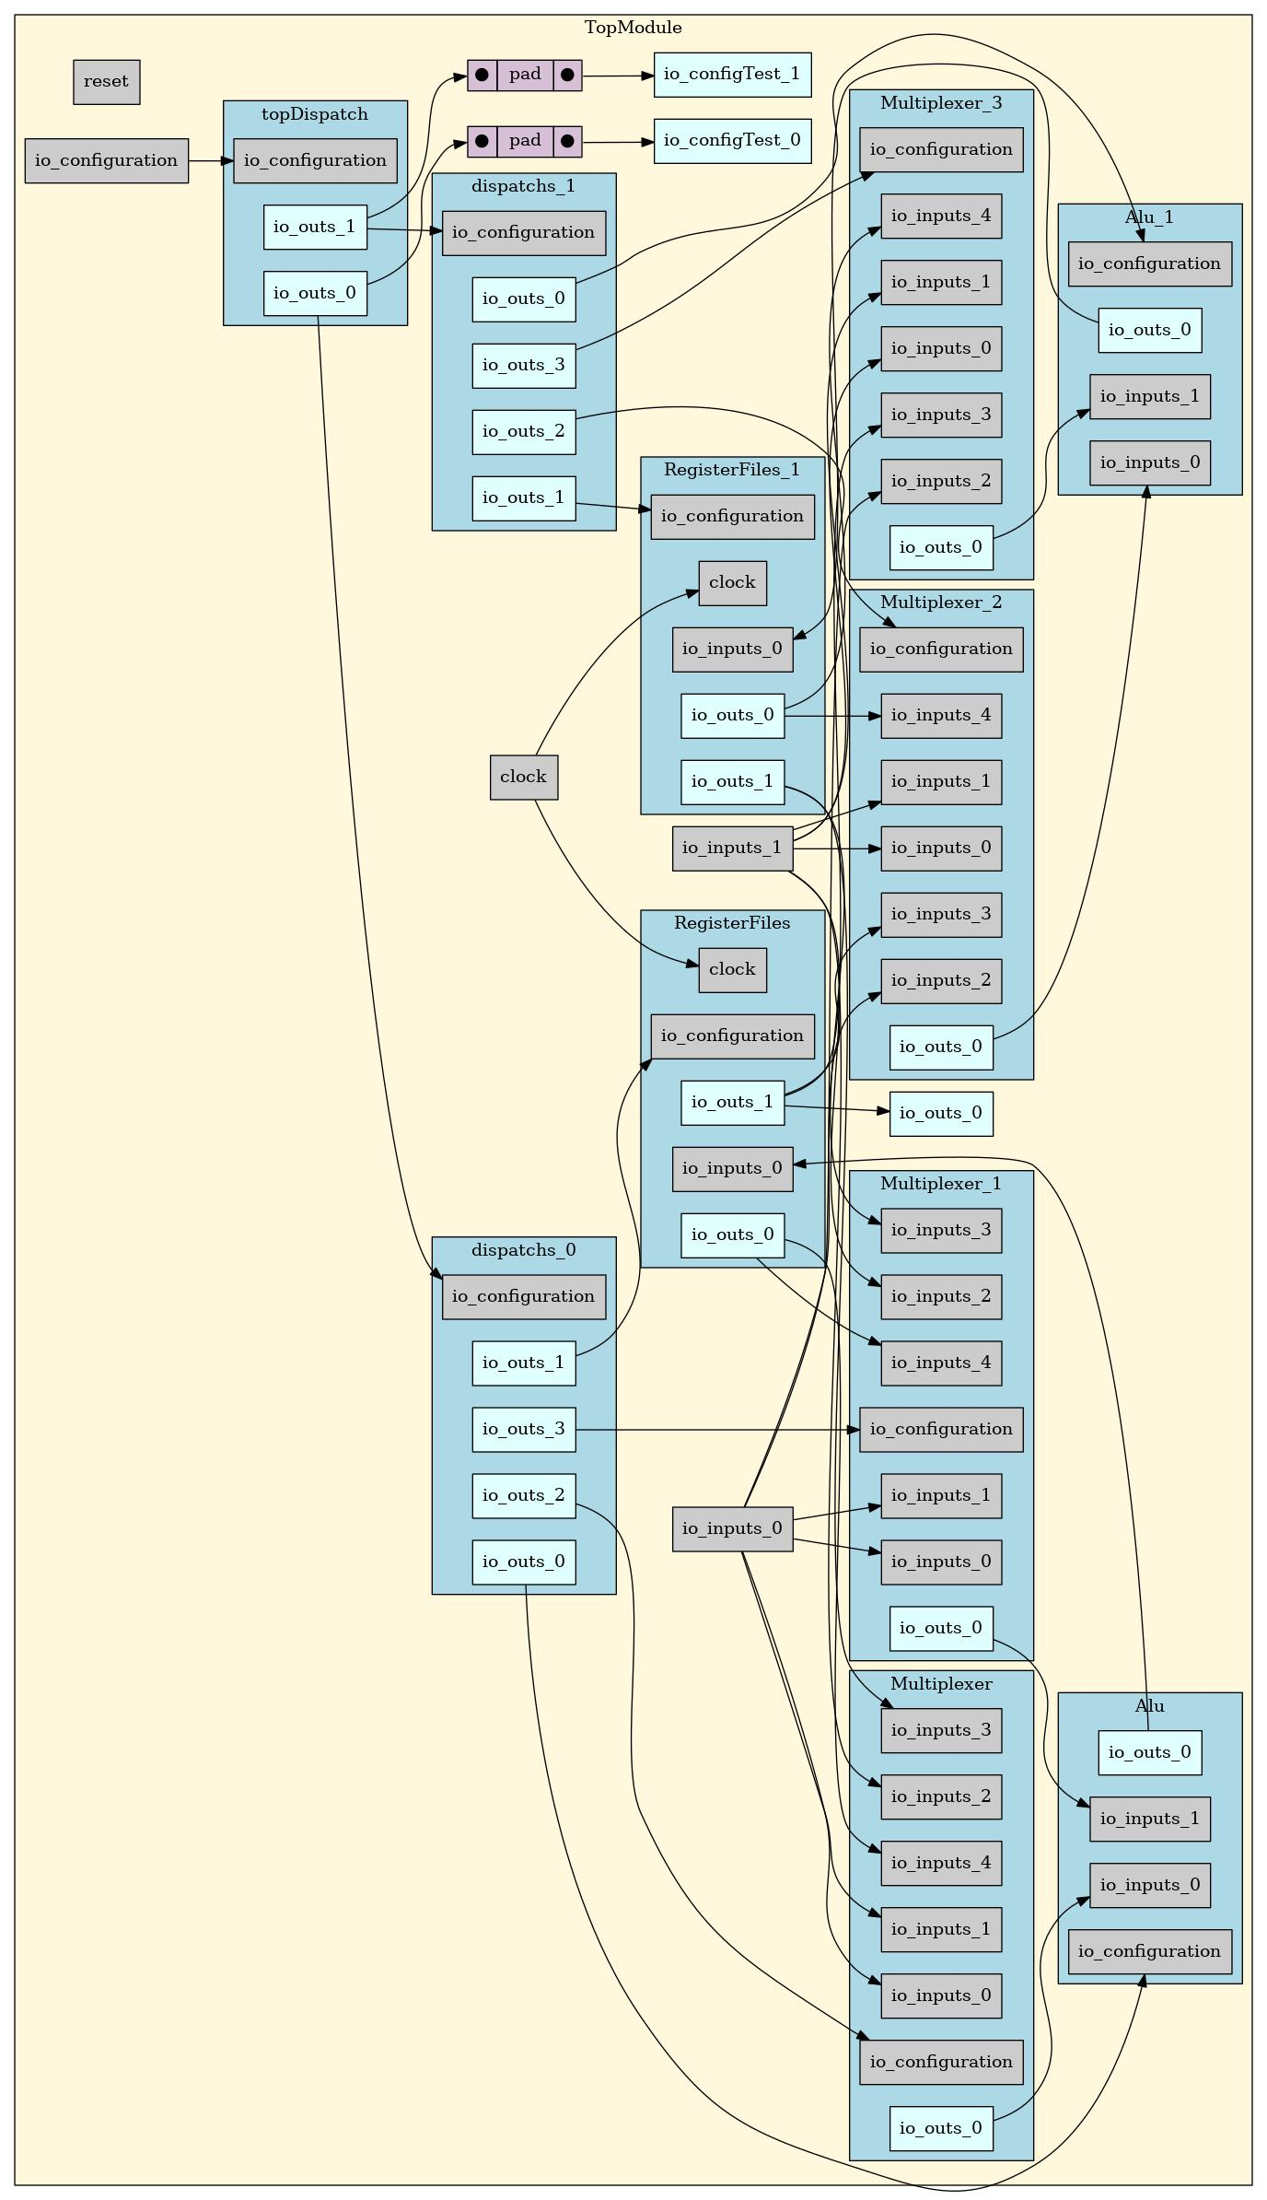
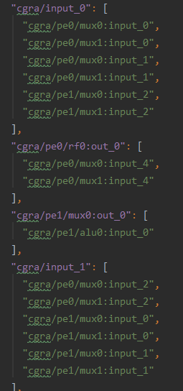
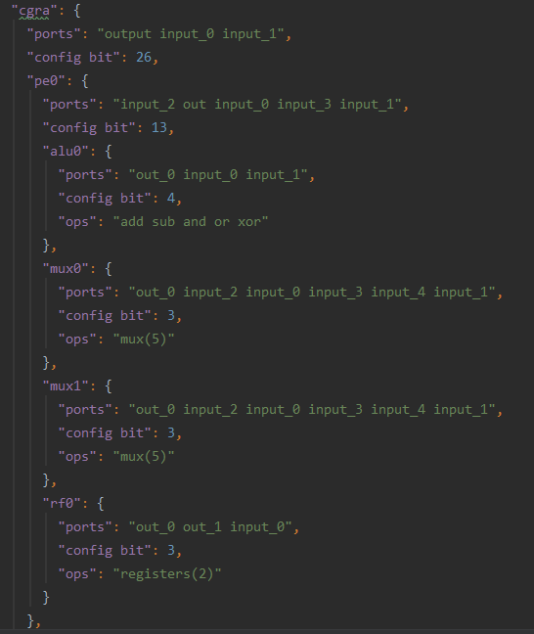

Outputs

